Slide 1
Health Reimbursement Arrangement
Qualified Expenses
Let employer-funded savings help pay for healthcare expenses.
Enjoy tax-free benefits for qualified healthcare expenses with a Health Reimbursement Arrangement.
Use your tax-advantaged Health Reimbursement Arrangement (HRA) to pay for qualified healthcare expenses like doctor visits, prescriptions, and dental and vision care for you, your family, and any dependents. Examples of qualified expenses include the following:
Acupuncture
Adoption
Alcoholism treatment
Allergy and sinus medicine
Ambulance
Anti-gas products
Athletic brace support
Band-Aids
Birth control
Blood pressure monitor
Body scans
Braille books and magazines
Breast pumps and lactation supplies
Chiropractic care
Cholesterol test kit
COVID-19 PPE (hand sanitizers, wipes, and masks for personal use)
At home COVID-19 testing kit
Co-insurance (medical, dental, prescription and vision)
Contact lenses
Contraceptives
Cough, cold and flu
Crutches or canes
Deductibles for plans (medical, dental, prescription and vision)
Dental care (non-cosmetic, reconstruction, dentures)
Diagnostic services
Drug addiction treatment
Eye exams
Eyeglasses (Rx and reading)
Eye surgery
Family planning items
Fertility treatments
First aid kits
Flu shots
Guide dogs
Hearing aids and batteries
Hospital services
Immunizations
Incontinence supplies
Infertility treatments
Insulin and diabetic supplies
Laboratory fees
Lamaze classes
Laser eye surgery
Learning disability treatments
Mastectomy-related special bras
Medical equipment and repairs
Medical supplies
Medical testing devices
Menstrual care products
Nursing services
Obstetrical expenses
Office visits
Operations
Organ transplants
Orthopedic supports
Over-the-counter (OTC) treatments containing medicine: cold treatments, ointments, pain relievers, stomach remedies, etc.
Over-the-counter (OTC) medications without a prescription
Oxygen
Physical exams
Physical therapy
Prescription drugs
Prosthesis
Psychiatric care
Removal of benign cyst, mole or tumor
Respiratory treatments
Sleep aids
Smoking cessation
Speech therapy
Sunglasses (Rx)
Sunscreen
Surgery
Transportation and travel expenses (essential to receive medical care)
Vasectomy
Vision products (OTC)
Weight loss program (to treat a medical condition)
Wheelchair and walkers
X-ray fees

Slide 2
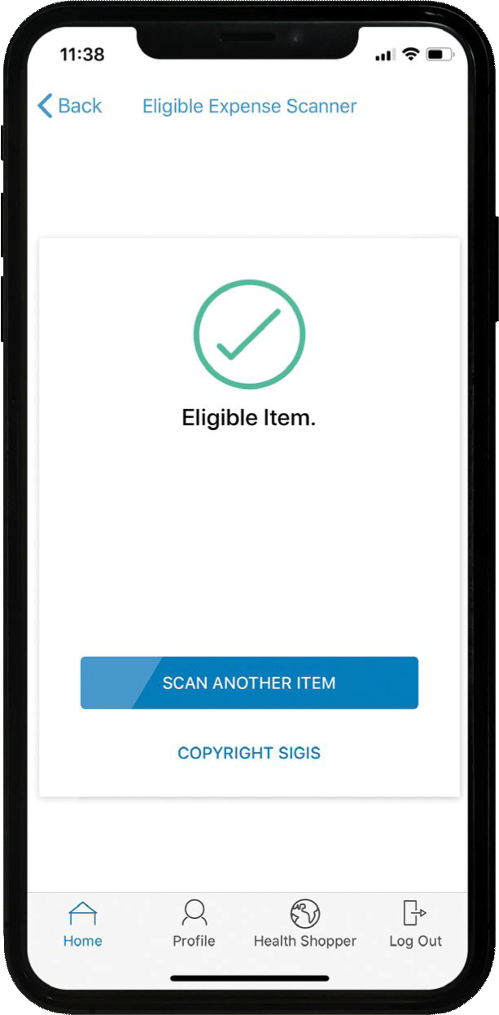
Health Reimbursement Arrangement (HRA)
These expenses are typically not treated as qualified expenses.
Concierge service fees
Cosmetic surgery
Deodorant
Exercise equipment
Fitness programs
Funeral expenses
Hair transplants
Household help
Illegal operations and treatments
Maternity clothes
Teeth whitening
There are thousands of qualified expenses you can cover with your HRA. Some items may require a Medical Necessity Form or prescription from your doctor.
For a complete list of qualified expenses, go to IRS Publication 502.¹
Eligible Expense Scanner
Use the eligible expense barcode scanner on the MetLife HS&SA mobile app to immediately see if the product is qualified under your HRA. It makes using your account easy!
Manage your Health Savings & Spending Accounts on the go! To download, search MetLife HS&SA on the Apple or Android App Store on your mobile device.
This app is designed for your Apple device (including iPhone, iPad, and iPod touch) version 6.0 and higher or Android device, version 2.2 or higher.
iPhone, iPad, iPod touch, iOS, and Apple App Store are registered trademarks of Apple Inc. All other trademarks and service marks are the property of their respective owners.
Questions?
Contact Customer Service at (833) 571-0500 Monday – Friday, 8 am – 8 pm ET
https://HealthSavingsAndSpending.MetLife.com
¹In addition, there may be legislation or additional publications that may modify or expand available qualified expenses. Employees should refer to their employer’s plan document(s) for the latest list of qualified expenses under their plan.
Like most group benefit programs, benefit programs offered by MetLife and its affiliates contain certain exclusions, exceptions, waiting periods, reductions of benefits, limitations and terms for keeping them in force. Nothing in these materials is intended to be, nor should be construed as, advice or a recommendation for a particular situation or individual. Participants should consult with their own advisors for such advice. Federal and state laws and regulations are subject to change.
MetLife Consumer Services | 200 Park Avenue | New York, NY 10166
L1021017609[exp1023][All States][DC,GU,MP,PR,VI] © 2022 MetLife Services and Solutions, LLC

